Slide 1




YOUR RISE TO
Greater
heights
STARTS HERE.

Slide 2
What is the College Credit Plus Program?
The College Credit Plus Program was created by the Ohio Legislature to allow students in grades 7 -12 to earn college credits before graduating from high school.
  Students receive both high school and college credit simultaneously.
  Tuition, fees and textbooks related to the coursework are provided to the student free of charge.

Slide 3
Advantages for College-level Learning During High School:
Strengthening the high school curriculum and raising expectations for high school students.
Reducing the total number of credits needed to be earned in college.
Potentially reducing the time required for the baccalaureate and costs to parents, students, and taxpayers.
Enriching the undergraduate college curriculum by lessening the need to retake some introductory courses, consequently allowing earlier entry into more advanced courses, facilitating double majors, or permitting additional electives.

Slide 4

Potential College Credit Plus Expenses
Students must pay tuition expenses to the school district for any course withdrawals or failed courses.
Parking fees are the responsibility of the student if taking classes on the campus.

Slide 5
Failures & Withdrawals
If a student fails (a letter grade of “F”) or withdraws from any course(s) after the drop period, it is the student’s financial obligation to reimburse their school district (or state for nonpublic or homeschooled students) the amount of state funds paid to the University to contribute to their tuition and fees for that course(s).

Slide 6

Deadline for Students:
You must submit an INTENT TO PARTICIPATE FORM to your high school by APRIL 1 if you plan to participate next year.
Forms must be submitted each year.

Slide 7
How can students participate?
Step 1
Eligibility
Step 2
Admission
Step 3
Registration

Slide 8
How can students participate?
  Step 1: Eligibility
    Students must be “eligible” for College Credit Plus participation based on an unweighted cumulative high school GPA or assessment exam scores
  Students with an unweighted cumulative high school GPA of at least a 3.00 qualify for eligibility.
  Students with an unweighted cumulative high school GPA of at least a 2.75 will be evaluated to determine if an assessment exam is required.

Slide 9
Student Eligibility Assessment Exams
Students’ scores must show that they are ready for “college-level” courses in at least one subtest on an exam
Exams include ACT, SAT, Accuplacer, ALEKS, PlaceU, or MapleSoft
  Students will need to confirm exam requirements with the college
  Colleges and universities will review students’ scores using statewide standards

Slide 10
How can students participate?
Step 2: College Admission
  Students must apply for admission
  Students must meet admission requirements of the college
  Students must complete a “Permission Slip” that will be provided to the students with the college’s application for admission.
  Contact the college to learn about their requirements, processes, paperwork, and deadlines
  Colleges have the final decision on student admission
  If the student is admitted to the college, the college will send a “Questionnaire” that must be completed for enrollment.

Slide 11
Mature Subject Matter
A student eligible to participate in College Credit Plus and admitted to a college or university will enroll in actual college courses, which may include “mature subject matter” as defined in Ohio Revised Code 3365.035.
The subject matter of a course enrolled in under the college credit plus program may include mature subject matter or materials, including those of a graphic, explicit, violent, or sexual nature, that will not be modified based upon college credit plus enrollee participation regardless of where course instruction occurs.
Students and parents are required to sign a permission slip acknowledging they understand that college courses may include mature subject matter.

Slide 12
How can students participate?
Step 3: Course Registration
  If the student is considered eligible and has been admitted to the college, then:
    The college will discuss course options with the student, based on assessment scores, prerequisites, and other requirements
    Students may be required to complete an orientation and meet with a college advisor in order to enroll in classes

Slide 13
Allowable Courses
Students may only enroll in “Level I” courses within the First 15 Credits
Level I Allowable Courses Include:
Transferable courses: Ohio Transfer 36 (OT36), Transfer Assurance Guide (TAG) or Career-Technical Assurance Guide (CTAG)
Courses in computer science, information technology, anatomy, physiology, or foreign language, including American Sign Language
Most Level I courses are part of the General Education Program at The University of Akron.
Level II - Any other college course that is not a Level I course
Exceptions to the “First 15” Rule may be made if the student wishes to continue with course in the same subject or tests directly into Level II course. Students who have attained the required scores on AP or IB course examinations may count the course toward the First 15.

Slide 14
Non-Allowable Courses
One-on-one private instruction courses such a Music Lessons
Physical Education courses
Remedial courses (non-credit, developmental courses such as Basic Writing or Fundamentals of Math)
Students can choose to pay for Music Lessons or Physical Education courses, but it is up to their high school to determine if the courses will count for high school credit. Students cannot pay to take remedial courses.

Slide 15
Class Selection
College Credit Plus students may take a wide variety of university classes, but many take General Education or core classes which also fulfill high school graduation requirements. Most core classes meet the “Level I” allowable course rule. Students must meet necessary placement and/or prerequisite requirements.
Classes have included:
  Government & Politics in the U.S.
  Economics
  English Composition
  Sciences
  Foreign Languages
  Psychology
  Sociology
  Speech
  Mathematics

Slide 16
Differences Between High School & College
Tests & Grades
High School: Tests are sometimes given weekly or at the end of the chapter
Information provided mostly in-class. Out-of-class research is minimal
College: Tests are generally fewer in number and cover more material
Less homework assignments which will be used to determine final grades
Study Time
High School: Required homework ranges between 1 to 3 hours per day
College: Standard rule of 2 to 3 hours of homework for every hour spent in class (3 to 5 hours per day)

Slide 17
Differences Between High School & College
Role of Parents
High School: Parents are strong advocates working closely with teachers and counselors
College: Parent serves as a mentor and support for the student; the college views the student as independent decision-maker
College: The Family Education Rights and Privacy Act (FERPA) protects student education records
Accommodations
High School: Parents and students work with high school staff to determine what assistance or accommodations can be made for students with IEPs or 504 plans.
College: Students must work directly with college staff to determine if accommodations are needed. IEPs and 504 plans may or may not be included in the discussions.

Slide 18

The grades you earn in the college courses will be recorded on your college transcript and your high school transcript.
The grades may satisfy high school required or elective classes.
College courses must be weighted equally to the greatest weight of Advanced Placement, International Baccalaureate or honors classes, in the same subject area.
Grades are Applied to High School Transcripts
AP, IB, Honors
Class
College
Course

Slide 19
Probation and Dismissal
Students must achieve a minimum 2.0 GPA to remain in “Good Academic Standing”.
Students will be placed on Academic Probation if the GPA falls below a 2.0 after their first semester, or if they withdraw from two or more courses.
Students on probation may enroll in no more than one course in the subsequent semester and cannot take courses in the same subject area that they earned D or F grades.
Students are eligible for dismissal if the GPA remains below a 2.0 for two consecutive semesters.

Slide 20
CCP Credit Limit
The maximum number of college credits that can be taken in a school year are 30 (including summer, fall & spring.)
Students may pay to take more than 30 credits.
Students can earn up to 120 college credit hours while in the program.

Slide 21

A semester college course of 3 or more credits counts as a one-year high school class.
Ex. English Composition 111 (3 credits) fulfills
one full credit of high school English.
College courses worth less than 3 college credits are divided by 3 to determine equivalent high school credits.

Slide 22
Sample Schedule
School Name | Course | Duration | HS Credits | College Credit Equivalency
Bayside HS | Algebra II | All Year | 1 | 3
Bayside HS | Chemistry | All Year | 1 | 3
Bayside HS | American History | All Year | 1 | 3
Bayside HS | Spanish 3 | All Year | 1 | 3
Bayside HS | Band | All Year | 1 | 3
The University of Akron | English Composition I | Fall | 1 | 3
The University of Akron | Intro to Public Speaking | Fall | 1 | 3
The University of Akron | English Composition II | Spring | 1 | 3
The University of Akron | Intro to Psychology | Spring | 1 | 3
Total Credits = 27
EXAMPLE:
Student is enrolled in high school credits
Student is eligible to take 15 college credit hours during the academic year (summer, fall & spring.)
5x3=15
30-15=15

Slide 23
Options after High School
Always remember that your participation in College Credit Plus is the start of your college transcript.
Even if you plan continue at the same institution after graduation, you must reapply in your senior year.
  The state universities and community colleges in Ohio will still consider you a new freshman so you can be considered for scholarships selective opportunities such as the Honors Colleges.

Slide 24
Applying to Other
Colleges and Universities
All subsequent colleges/universities will require an official copy of your college transcript when you apply.
Transferability vs. Applicability
Although credits taken will transfer within the state university system of Ohio, the receiving institution will ultimately determine how the credits apply.
You can visit the Ohio Department of Higher Education website to learn how your credits may transfer within the University System of Ohio: https://transfercredit.ohio.gov/students

Slide 25

https://transfercredit.ohio.gov/students

Slide 26
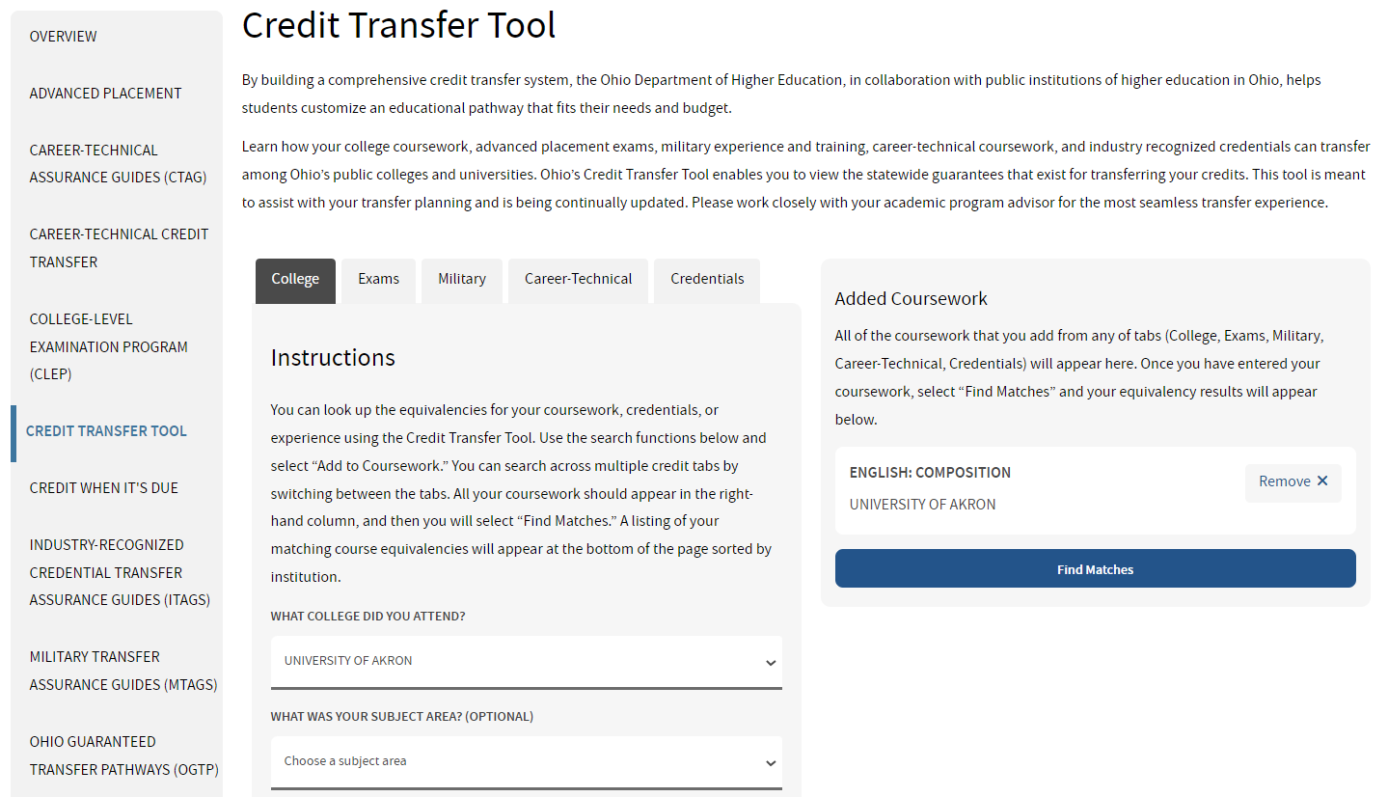

Slide 27
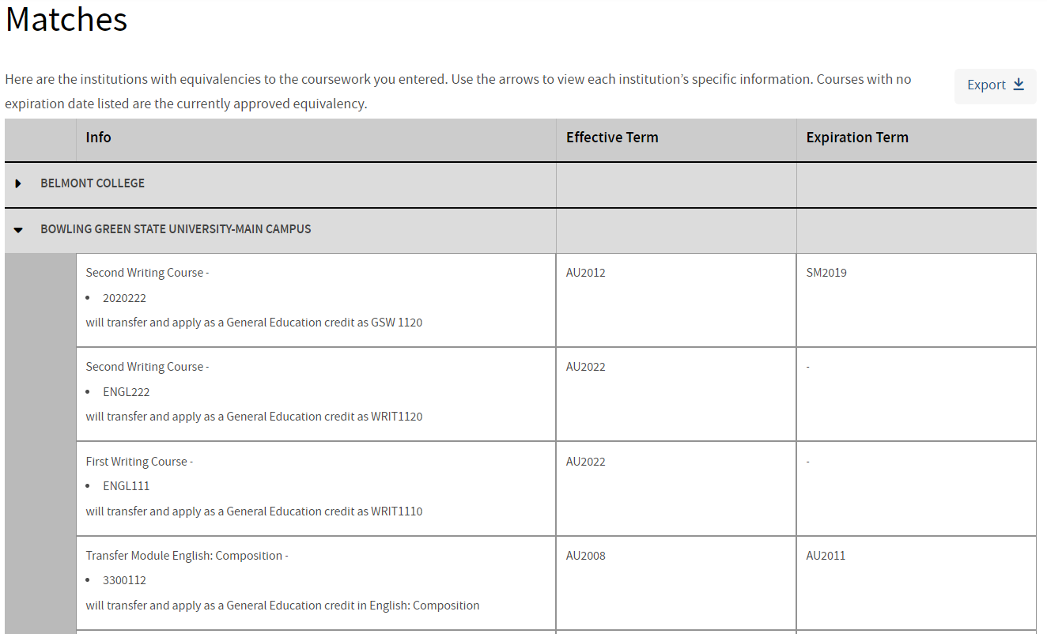

Slide 28

Transferology www.transferology.com

Slide 29
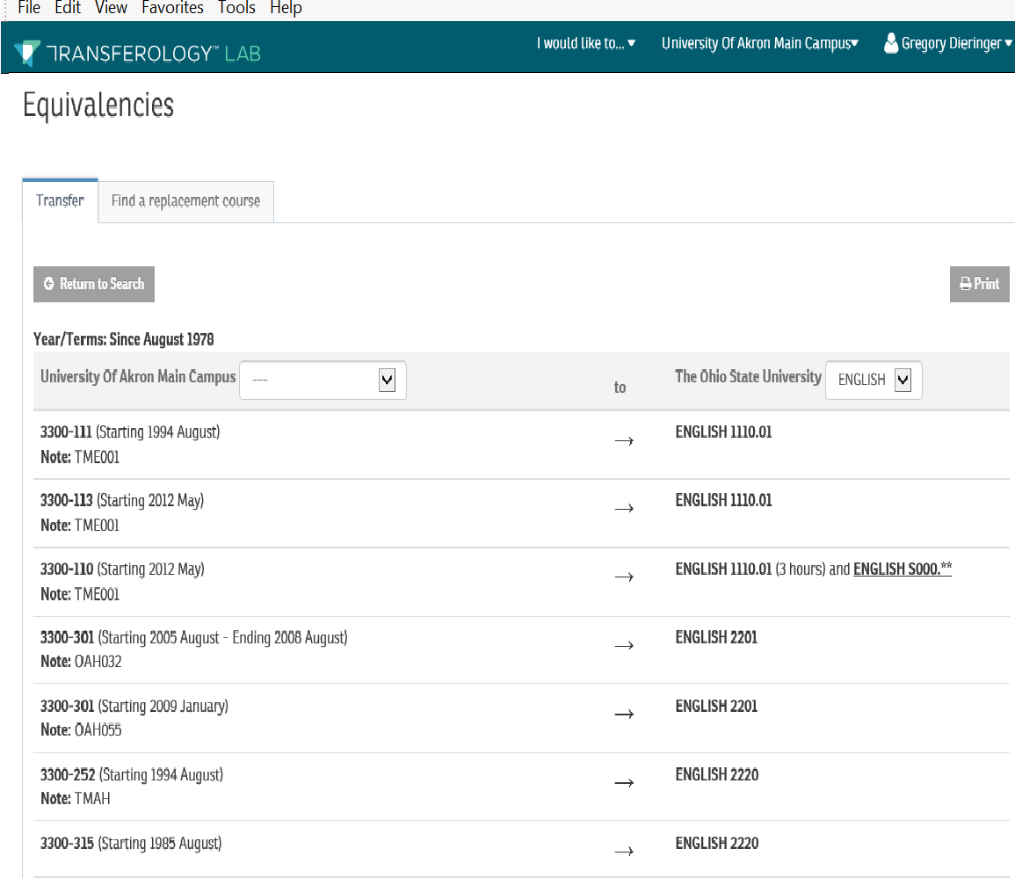

Slide 30





Options for Classes through UA…
Wayne College
Akron Campus
UA Medina
Distance Learning
or onsite in the
High School
Online

Slide 31
Distance Learning Classes
Since 1999, The University of Akron has committed millions of dollars to its distance learning facilities. Our classrooms are equipped with the latest multimedia and videoconferencing technology. The result is one of the most advanced and sophisticated synchronous distance learning networks in the state of Ohio, allowing instructors and students to interact and communicate live, and in real-time.

Slide 32
Distance Learning Courses
Introduction to Economics (ECON:100) – 3 credits
Applied Human Anatomy & Physiology I (ANAT:206) – 3 credits
Government & Politics in the US (POLIT:100) – 3 credits
Intro to Psychology (PSYC:100) – 3 credits
Exploring Music: Bach to Rock (MUSIC:201) – 3 credits
English Composition I & II (ENGL:111 & 112) – 3 credits each
English Composition I & II (ENGL:111 & 112) – 3 credits each
Courses rotate by semester, and some may require placement scores and/or completion of prerequisites.

Slide 33
CCP Admission Requirements
3.00 cumulative unweighted high school GPA
OR
Obtain at least one remediation-free score on the ACT or SAT as determined by the Ohio Department of Higher Education:
· ACT English of 18, ACT Reading of 22 or ACT Math of 22.
· SAT Evidence-based Reading & Writing of 480 or SAT Math of 530.
Students with at least a 2.75 cumulative unweighted high school GPA will be evaluated by the Office of Admissions to determine if ACT or SAT scores are required.
7th and 8th grade applicants without an established high school GPA must take the ACT or SAT.
Applicants admitted without test scores, or applicants with test scores who do not automatically place into college-level courses will be required to complete placement testing through the University.

Slide 34
How to Apply
Complete an Undergraduate Admission Application
Submit school transcripts
Print and Submit the Signature Page & Permission Slip
Submit ACT or SAT scores (optional for applicants with a 3.0 cumulative unweighted high school GPA)
The summer/fall application deadline is April 15
The spring application deadline is October 15
CCP Website: www.uakron.edu/ccp

Slide 35
Test Dates for 2025-26 Enrollment
National ACT – www.actstudent.org
Test Date Registration Date
            October 26, 2024 September 20, 2024
            December 14, 2024 November 8, 2024
            February 8, 2025 January 3, 2025
            April 5, 2025 February 28, 2025
Residual ACT – www.uakron.edu/counseling/testing
The University of Akron Testing Center offers individual administrations of the ACT. Please call 330-972-7084 to schedule a test.
National SAT – www.collegeboard.org
Test Date Registration Date
            December 7, 2024 November 22, 2024
            March 8, 2025 February 21, 2025
            District administrations of the National ACT or SAT for juniors in February, March or April will be accepted for summer/fall admission consideration.

Slide 36
Placement Testing
Students admitted without ACT/SAT scores, or students with test scores who do not place you into college-level courses, you will be required to complete placement testing through the University.
The University of Akron uses the ACCUPLACER for Writing and Reading Placement.
  Testing is administered in-person by a proctor.
  The Writeplacer is used for placement in English Composition.
  The Next-Generation Reading test is used for placement in Social Science courses (Psychology, Sociology, Government, Economics, or History)
Mobius (Maplesoft) is administered online for Math placement testing.
Students must complete placement testing prior to their enrollment.

Slide 37
New Student Orientation
All College Credit Plus students must attend a New Student Orientation.
During Orientation you will:
  Review important state and University policies
  Discuss course options and placement
    Necessary placement testing must be completed prior to enrollment
  Learn how to access MyAkron & Brightspace

Slide 38
General Information
College Credit Plus students follow The University of Akron calendar/schedule.
Your attendance is mandatory, as it is in high school.
UA transcripts will be issued to the students’ respective high schools at the end of the semester.
    Students can access their grades on the UA website through “My Akron”.
All textbooks are property of the school district and must be returned at end of the semester.

Slide 39
Academic Support and Resources
Students are encouraged to use academic support resources such at tutoring and the Writing and Math Labs.
Online e-tutoring is also available, especially for students enrolled in distance learning classes.
Students are also encouraged to take full advantage of resources such as the Library and email services.
Students with diagnosed physical or learning disabilities must register with the Office of Accessibility to assess eligibility for accommodations. Use of accommodations in high school does not guarantee eligibility of the same accommodations at the University.
Students are assigned an advisor who will enroll them each semester.

Slide 40
College Credit Plus Contacts:
Greg Landis, Admissions
Associate Director of Admissions
(330) 972-5827 or 1-800-655-4884
e-mail: glandis@uakron.edu
Greg Dieringer, Director
Director of College Credit Plus
(330) 972-7572 e-mail: gdierin@uakron.edu

Slide 41
Questions?

